Slide 2
20% Rank Information

Slide 3
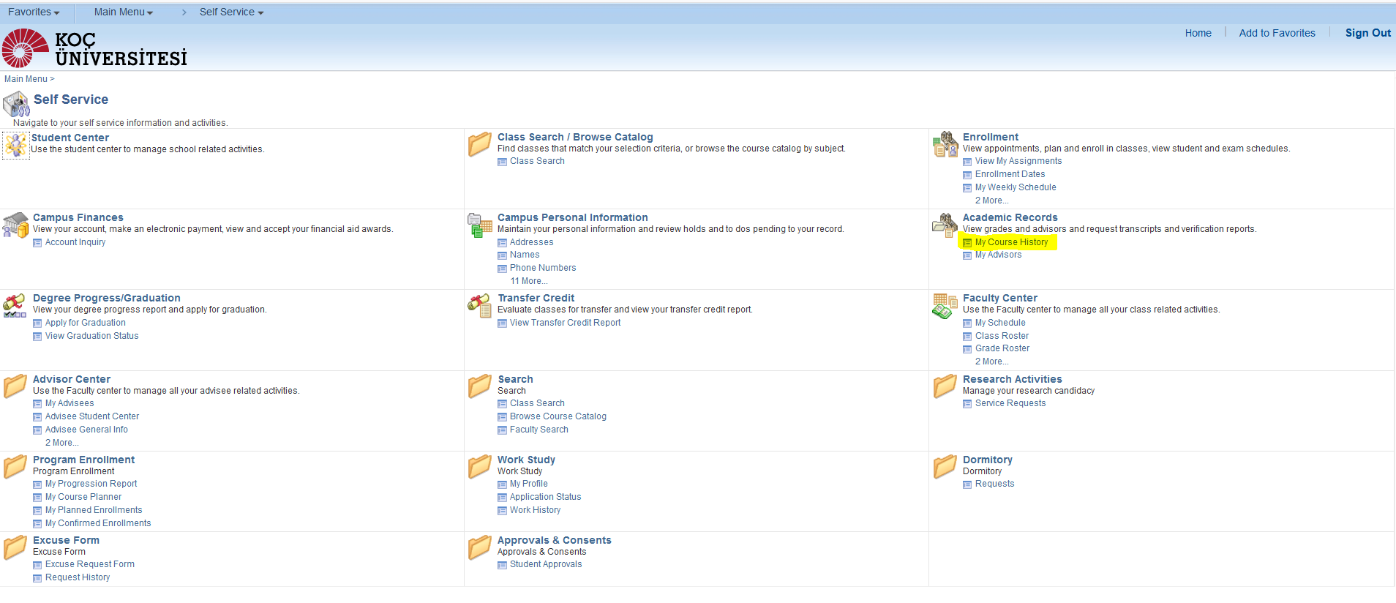
Step 1
Log-In to your KUSIS Account and Go to ‘My course History’ page

Slide 4
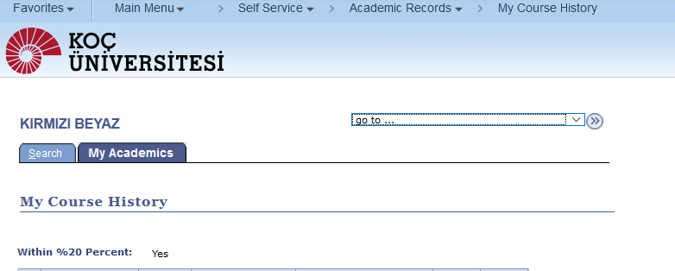
Step 2
Under My Course History page you can see whether you are in the top 20% in your main majör plan.

Slide 5
Step 3
Please note that this information is provided only for our active students. Our Graduate students can not see that.
THANK YOU

