Slide 2
Checking Student Availability

Slide 3
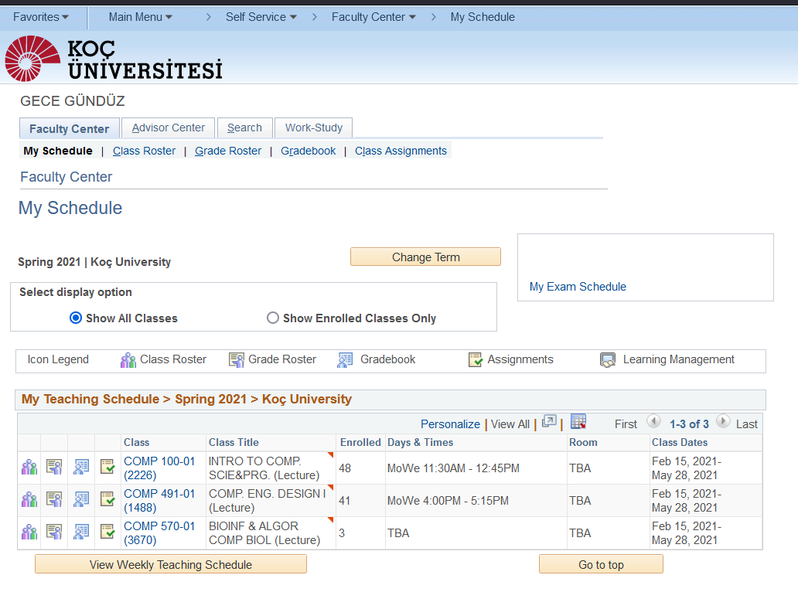
Step 1
Log-In to your KUSIS Account and Go to ‘My Schedule’ page
Check the term if it is correct
Find the course and right click on the red triange icon near the course title

Slide 4
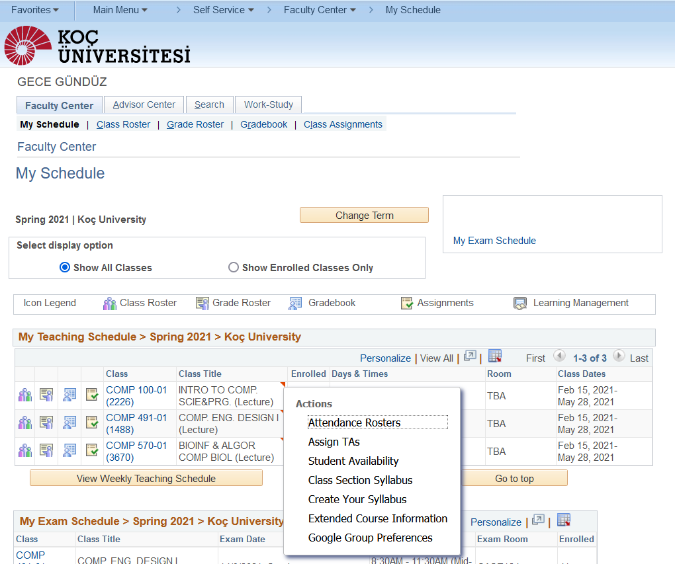
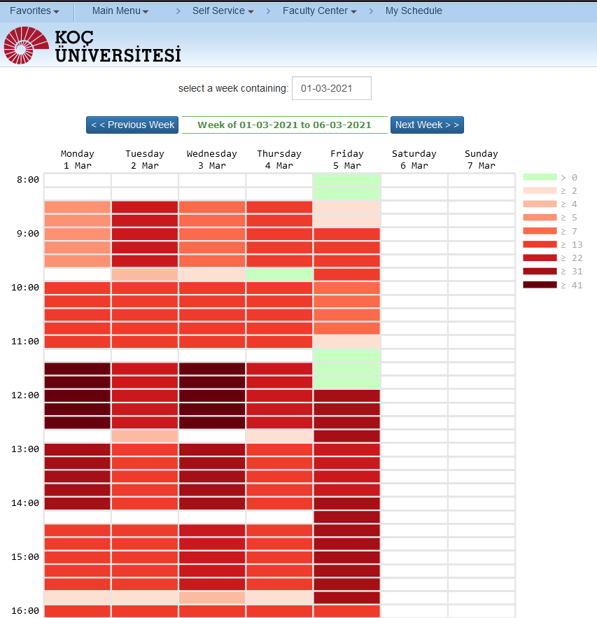
Step 2
Click the ‘Student Availability’ from the menü
You can check the Student availability on calender
By coming on the colored regtangular you can see the students’ ID number

Slide 5
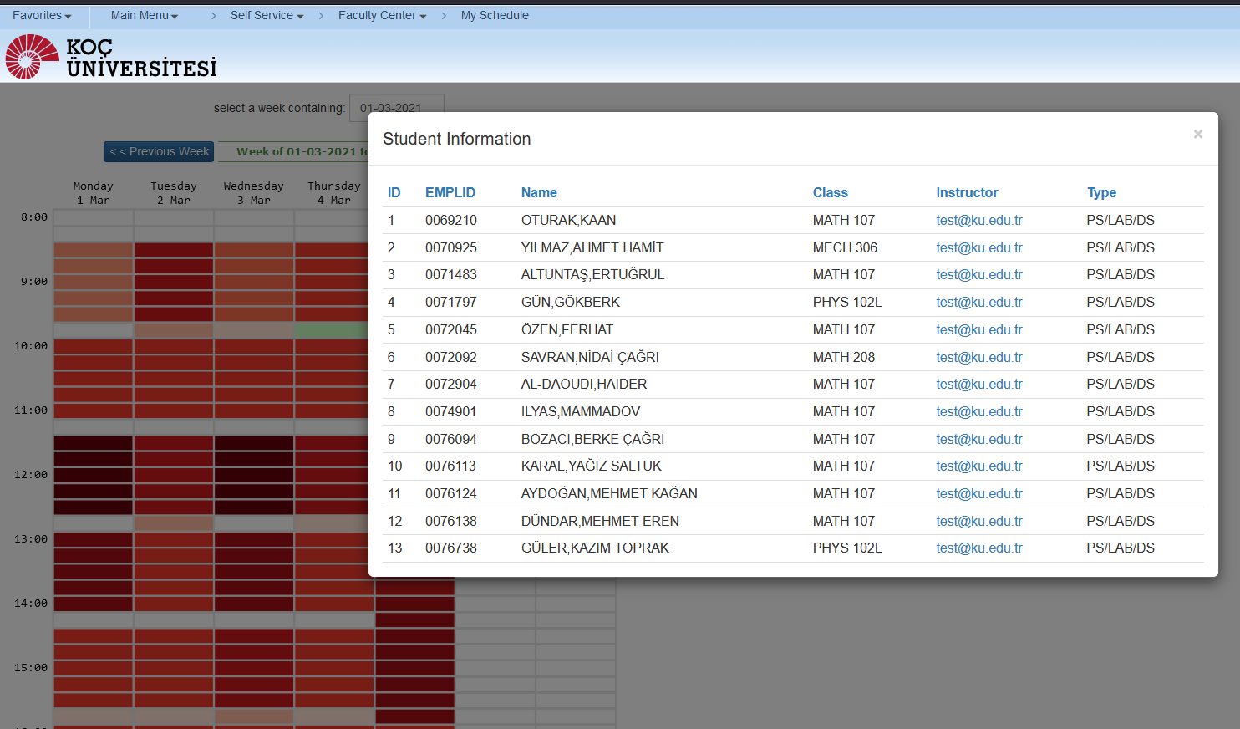
Step 3
Please note that colors show the availabity of the periods. Dark red is the busiets and the White is the most available
By clicking one of the time periods you can view what students have in details

Slide 6
THANK YOU

