Slide 2
How to View Class Roster with Student Photos as a List View

Slide 3
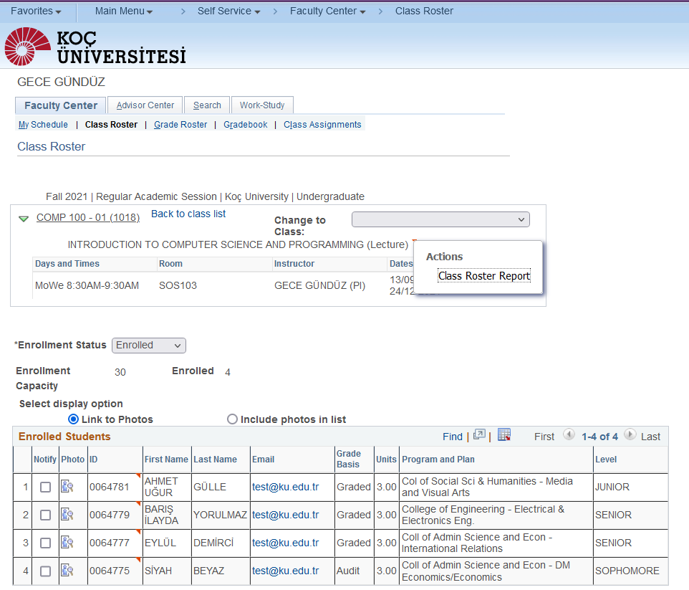
Step 1
Log in to KUSIS and go to Class Roster page
Right Click on the red triange near the course description
Take the Class Roster Report

Slide 4
Step 2
Please note that the report will be in PDF format

Slide 5
THANK YOU

